Slide 1
Itility Machine Learning Hackathon
Audio Tagging Challenge
1.0 by DKOO
24-5-2018

Slide 2

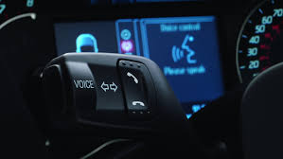
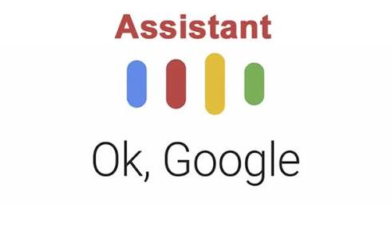
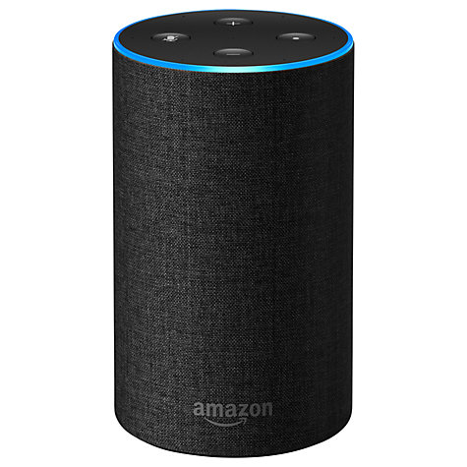

The use case
Audio recognition is a widely implemented technology, with many proven use cases.
So… let’s see if we can do it as well within a few hours ☺

Slide 3
The data
The training set for this hackathon consists of ~2600 audio samples (.wav)
The test set consists of 250 unlabeled audio samples
Containing 10 different classes:
Applause
Burping / eructation
Cough
Double bass
Fart
Fireworks
Saxophone
Squeak
Tearing
Trumpet
Length differs from 29 sec. to <1 sec.

Slide 4
The data
Training samples have their labels in the filename:
Fireworks_18b3013e.wav
Test samples only have unique file id:
3e8687d9.wav
train.csv file contains a lookup for labels, if needed:
"filename","label"
"Applause","Applause_03320f05.wav"
"Applause","Applause_048fb352.wav”
sample_submission.csv contains the format on how to submit

Slide 5

The data
Applause
Double bass
Saxophone
Tearing
Burp
Fart
Squeak
Trumpet
Cough
Fireworks

Slide 6
The goal
Correctly classify as many samples as possible
Score is calculated as percentage correct
Give a 2min. presentation on your approach
Scoring will be done based on Marianne’s famous applause meter

Slide 7
Submissions
Mail your submission to:
daniel.koops@itility.nl
Keep in mind:
Some programs order hexadecimals in a different order!!
Stick to the order of the sample_submission file
Use a ‘;’ as separator, makes my life easier ☺

Slide 8
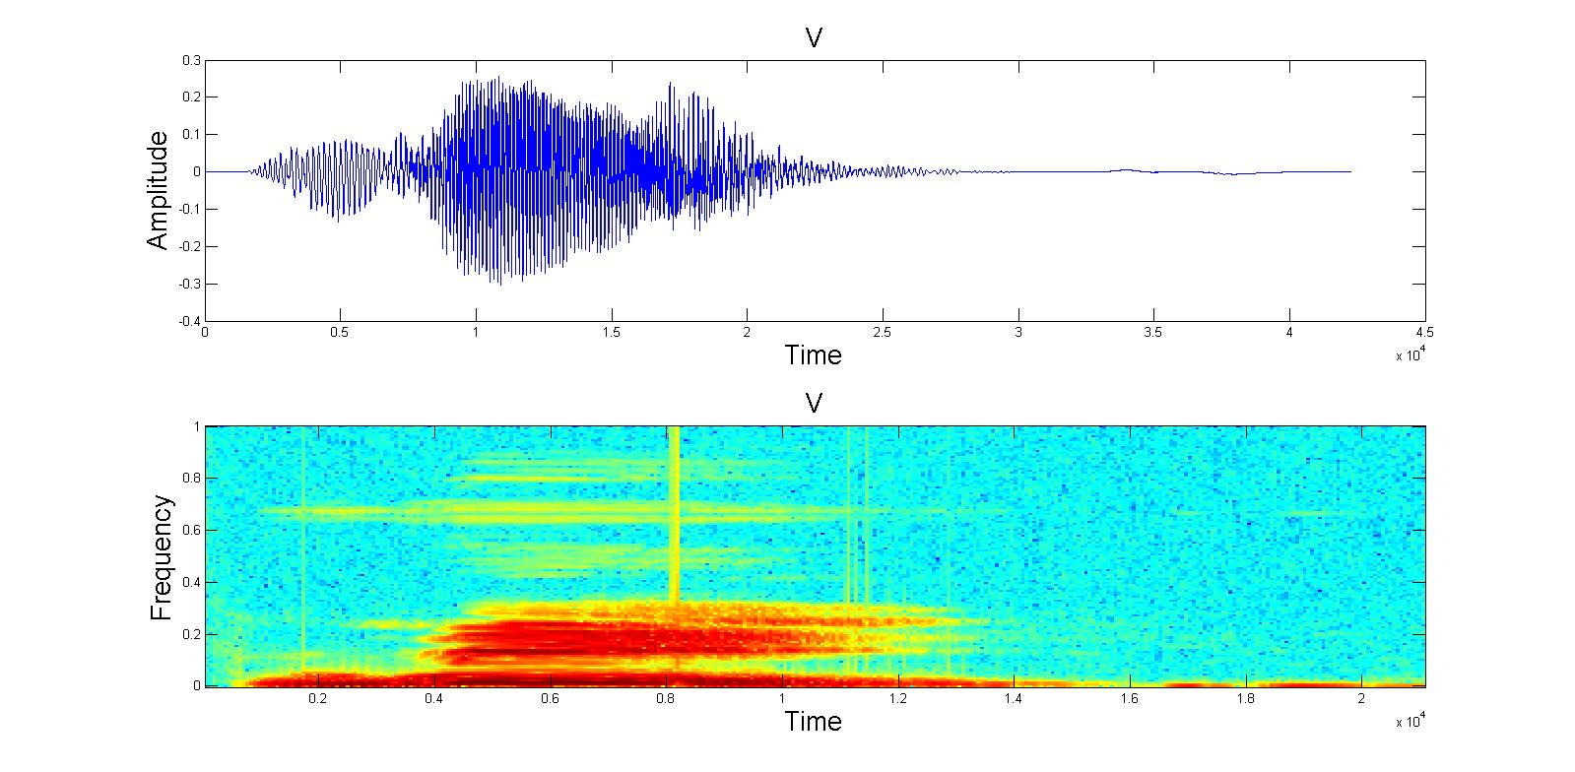
Some tips to get you going
Python, R, and MatLab have great audio processing libraries
Librosa
tuneR
Audio is just a timeseries.. →
..or simply an image →
Fast Fourier Transformation is a thing…
So is Mel-frequency cepstrum…

Slide 9
The data
Download the data from:
…

